Slide 1
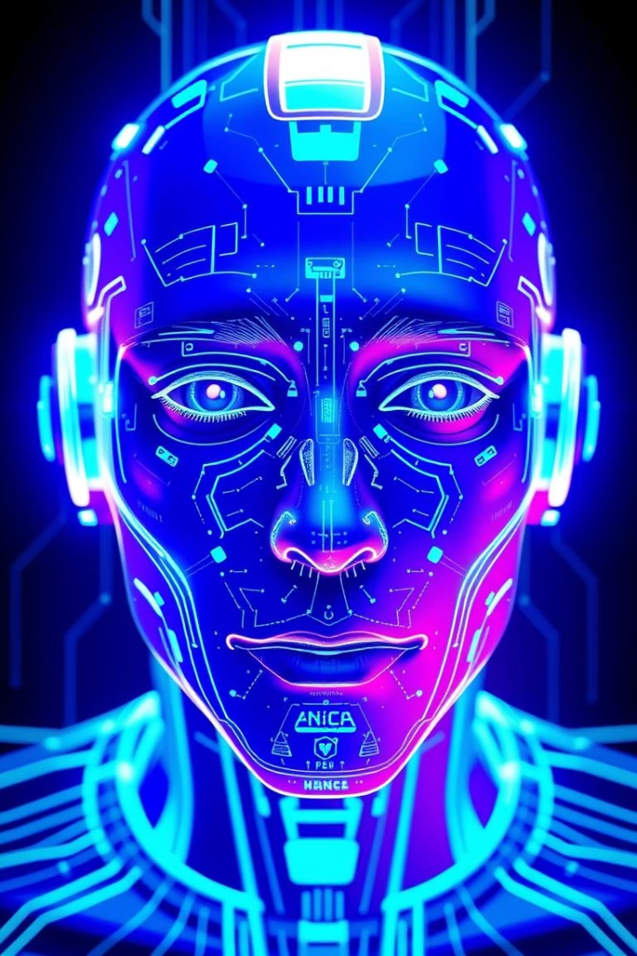
AI in Social Engineering and Phishing: An Overview
AI is transforming cyberattacks by making social engineering more effective. Social engineering manipulates people to gain access. Phishing tricks victims into revealing sensitive info.
This presentation explores how AI boosts attack sophistication and efficiency.
Group members:-
Omkar Bhambid
Prabhav Nerurkar
Nikhil Damse

Slide 2

The Problem: Social Engineering Vulnerabilities
Human Weakness
Humans remain the weakest security link in breaches (Verizon DBIR).
Detection Limits
Current phishing detection tools often fail against evolving attacks (APWG).
Financial Impact
Phishing caused losses over $4.2 billion in 2020 alone.
Rising BEC Threats
Business Email Compromise attacks increased 24% last year (FBI IC3).

Slide 3

AI as the Solution... for Attackers
Email Automation
AI crafts highly personalized phishing emails at scale.
Fake Profiles
AI generates realistic social media profiles to build trust.
Voice Cloning
Voice AI imitates trusted voices to deceive victims.
Deepfakes
Convincing deepfake videos manipulate targets emotionally.

Slide 4
Code/Tool Breakdown: AI Phishing Toolkit
GPT-3
DeepFaceLab
Wavenet
OpenPhish
Generates convincing, personalized phishing emails.
Creates realistic deepfake videos for social manipulation.
Clones voices with natural intonation for audio deception.
Helps bypass phishing detection using known phishing data.
Example: Python scripts scrape data to personalize phishing emails automatically.

Slide 5
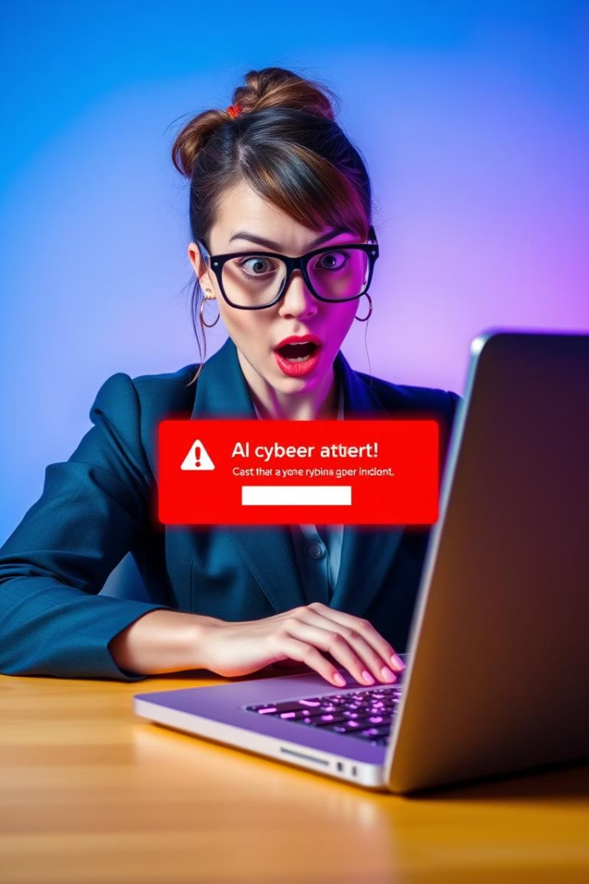



Real-World Use Cases: AI-Powered Attacks
CEO Deepfake Fraud
Cost company $35 million in a single scam (WSJ report).
Political Disinformation
AI-generated fake news campaigns sway public opinion (Oxford study).
Targeted Phishing
Customized AI phishing targets defense contractors (Mandiant report).

Slide 6




Countermeasures: Defending Against AI
AI Threat Detection
Biometric Security
User Education
Training employees to spot AI-generated deepfakes and phishing.
Systems like Darktrace proactively detect AI-driven threats.
Multi-factor authentication strengthens access controls.

Slide 7
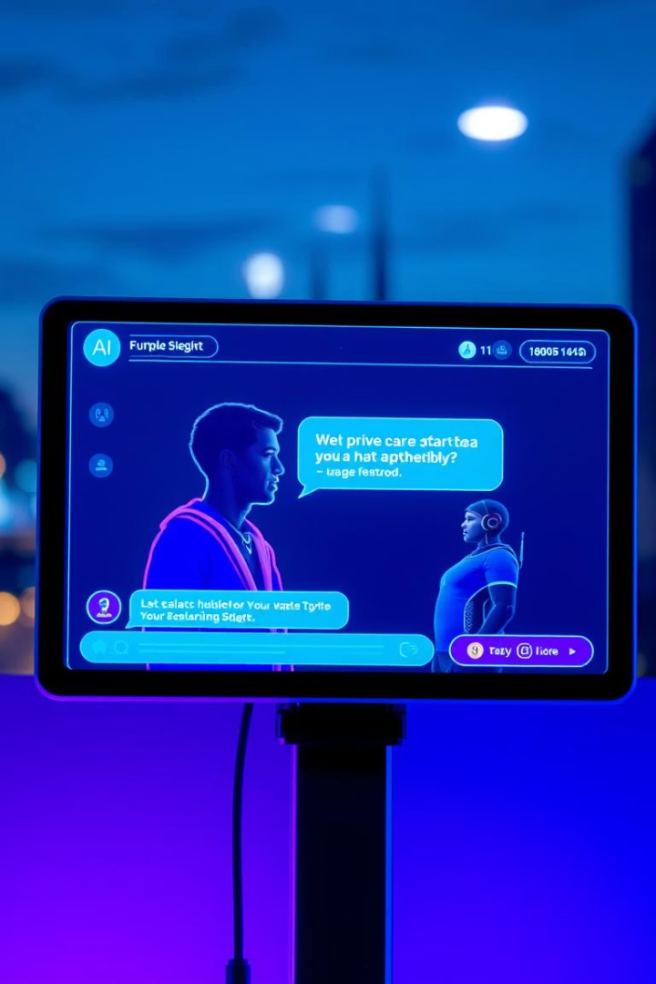
Future Enhancements: The Escalating AI Arms Race
1
Real-Time AI Manipulation
2
Predictive AI
AI forecasts victim behavior to increase success rates.
Chatbots capable of manipulating victims instantly.
3
Adaptive Attacks
AI adjusts tactics to evade new security measures automatically.

Slide 8

Conclusion: The Future of Trust
Changing Trust
AI reshapes how we assess authenticity and trust online.
Stay Vigilant
Remain alert to evolving AI-driven social engineering.
Invest in Tools
Use AI-powered detection systems for defense.
Continuous Training
Educate employees regularly about new AI threats.

Slide 9
GitHub Links of Group Members =>
OMKAR BHAMBID:- https://github.com/dragon-omk/finalproject
PRABHAV NERURKAR:- https://github.com/prabhav1628/Prabhav-Pranay-Nerurkar
NIKHIL DAMSE:- https://github.com/NikhilDamse/finalproject
Demo link:- https://youtu.be/ewpUTYIMIkc?si=MgIxAUiMH34Vb43w

